Slide 1
Steganography: Swappable Instructions
By: Blake Eicholtz, Ben Marshall, Kyaw Tun, Omer Srour

Slide 2
The Problem
Hiding information in such a way that an external party wouldn’t have any idea that information is hidden.
The motivation for this was introduced at the HotSoS conference by a team conducting research for the Naval Information Warfare Center. Their idea was swapping instructions midstream to hide messages.

Slide 3
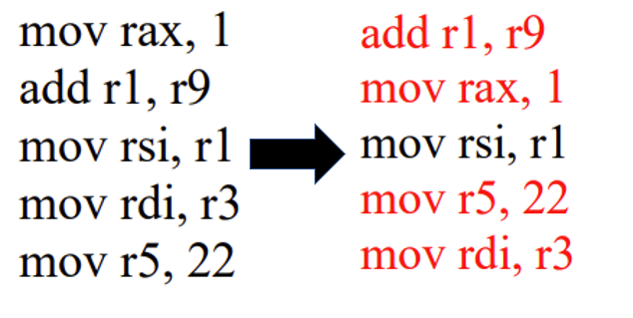
Swappable Instructions
Adjacent instructions that when switched have no effect on the program
Typically, instructions regarding unique registers
The main goal with swapping instructions is the program should run the same as it did pre-swap
We focused on MOV instructions
mov rax, 1 add r1, r9 mov rsi, r1 mov rdi, r3 mov r5, 22
add r1, r9 mov rax, 1 mov rsi, r1 mov r5, 22 mov rdi, r3

Slide 4
Our Method
For each pair of swappable instructions
If the order in the modified binary matches the original, the pair represents a 0
If the instructions are swapped in the modified binary, the pair represents a 1
Input data is broken down into binary and stored in the modified binary by swapping bits
mov rax, 1 add r1, r9 mov rsi, r1 mov rdi, r3 mov r5, 22
mov rax, 1
add r1, r9 mov rsi, r1 mov r5, 22 mov rdi, r3
0
1
Notes:
Blake

Slide 5
Our Method (cont.)
Ghidra plugin to analyze the binary and find pairs of instructions that can be swapped
To keep things simple only MOV instructions are considered
C++ program that reads the output from the plugin and swaps the instructions in the original binary to create a new binary containing the encoded message
C++ program that reads the output from the plugin, the original binary, and the modified binary to extract the message
Notes:
Blake

Slide 6
Prototype Demonstration
Notes:
Ben

Slide 7
Project Magnitude
Intelligence Community
US spends over $17,000,000,000 on cybersecurity
Encryption is already available to hide the contents of a message, but it is still possible to tell that encrypted messages are being sent
Steganography can be used to hide the fact that a message is being sent at all
The two can be used together

Slide 8
Future
Midstream swapping
If the original binary is publicly available, you can tell if it has been modified using our method
Our method only works for programs that aren't publicly available
Expand to more instructions other than MOV
Increase the amount of data stored in a program
Support RIP relative addressing
Limitation of sleigh in Ghidra
Increase the amount of data stored in a program

